Slide 1
Cloud Service Provider Recommendation
Shraddha Varvadekar
Swapnil Patel
Fatemeh Farahani

Slide 2
Contents
Data Reduction and Cleaning
Prediction Analysis
Evaluation Result

Slide 3
Project Idea
The aim of the project is to give recommendation of a cloud provider for services to new user/company from the available dataset of cloud service providers
It helps in predicting if the new company can or cannot opt a cloud service
This is accomplished using two ways:
Prediction done by implementing a Decision Tree in R
Prediction done using a heuristic approach in Python

Slide 4
Preparing Dataset
Our dataset has 11 attributes:
Cloud User Company -> which will be taken as input for Decision Tree
Cloud Provider Company -> which will be used as class label in predicting the cloud service
Numeric Data -> Number of Employee, Price, Customer Satisfaction, Revenue
Nominal Data - > the services which are provided by the cloud companies
The major focus is on the ‘revenue’ from the dataset to do our analysis

Slide 5
Prediction using R
Data Reduction
This being the first step reduction is performed by removing the column – cloud user company
We then perform chi-square on nominal data
Chi-square is performed on nominal data with two hypothesis
{ 𝑯𝟎=there is no correlation between two attributes}
{𝑯𝟏 =there is significant correlation between two attributes}
iii. By assuming significance level alpha=0.05

Slide 6
We perform correlation coefficient on the numeric data
We do a min-max standardization and bring the data in 2 digit range
After we categorize the data we also generate Scatter plot and Q-Q plot which helps in better understanding of the distribution of data
These plots help us in defining the ‘binning range’ for the data
Number of Employee | Revenue | Price | Customer Satisfaction
High | High | High | Happy
Medium | Medium | Medium | Mutual
Low | Low | Low | Unhappy

Slide 8
Predictive Analysis – Decision Tree
The next step after we bin the data and bring it in one standard form is to form the decision tree to do the analysis
The focus of this analysis using decision tree is to recommend the most used cloud provider company to any user
The testing and training data are divided into half
We first plot the decision tree based on the test data, this test data is further given to the training data which performs the prediction

Slide 9
Evaluation of Decision Tree
For evaluating the decision tree we take into consideration the misclassification rate
Pruning was performed to improve the misclassification rate

Slide 10
Misclassification rate seed(4321) : 0.9746835
After pruning, misclassification rate seed(4321) : 0.9367089
With Pruning
Without Pruning

Slide 11
Visualize cross-validation results of the seed
seed(4321)

Slide 12
Prediction Output
Inputs | seed(4321) and data point 49 | seed(4321) and data point 1
Price | Medium | Medium
Revenue | Low | High
Number of Employee | Low | Low
Customer Satisfaction | Unhappy | Mutual
Infrastructure Service | No | Yes
Software Service | No | Yes
Cloud Security Service | No | Yes
Result: (without pruning) | EMC | AWS
(with pruning) | EMC | AWS

Slide 13
Prediction using Python
We took a heuristic approach to define our analysis
We develop an input profile of a company which will be matched with the attributes present in the dataset
Input profile for a company is ‘revenue’ and the ‘cloud services’ it would like to use
We separate out all the ‘true’ values from the services
We do standardization of the price range using boxplot analysis
Based on the range it forms ranges for the services (min-max)
We then compare the revenue and services values to price and provide the name of the provider with least ‘price’

Slide 14
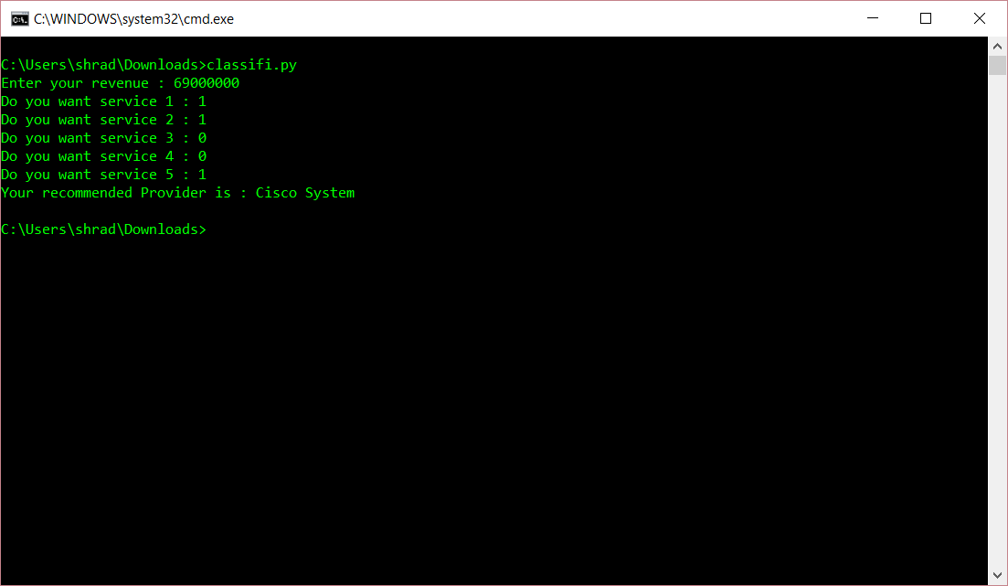

Slide 15
Challenges
Dataset : creation of entire dataset for each attribute
Few rows of dataset to expand the analysis
Data standardization with multiple attributes in the dataset such as numeric and nominal
Implementing the decision tree to closely match the project idea

Slide 16
Future Work
Implement decision tree in a better way
Define the heuristic approach to better provide cloud user company
Use the database to store and evaluate the results

Slide 17
THANK YOU

